Slide 1
Online Counseling

Slide 2

Hello!
I AM HM Mahmudul Hasan

Slide 3
Online Counseling
Users :
Teacher
Students

Slide 4
User
Update Courses
Update Trimester

Slide 5
Main Goals
Post The Problems
students will post the problem on the website.
Get The Solution
other students & correspondent teacher will give the solutions.

Slide 6
Other Features
Message
Student to Teacher to Student
Notifications
correspndent students will get notification .
teachers announcement.
Course Path
a brief idea for a desired course & it's Prerequisite courses.

Slide 7

Post
Students can Comment & give Vote to the Answer.
Teachers can Approve it as a correct answer.

Slide 8
Top Contributor
Base on giving correct answer , A top contributor ranking will be created.

Slide 9
Notification
Problem Notification to Correspondent Course Participants.
Teacher Announcement.

Slide 10
Message
In a common thread for a single course communication with teacher.
Private thread for student to teacher.

Slide 11
Similar existing project
ELMS has the message & announcement system.

Slide 12
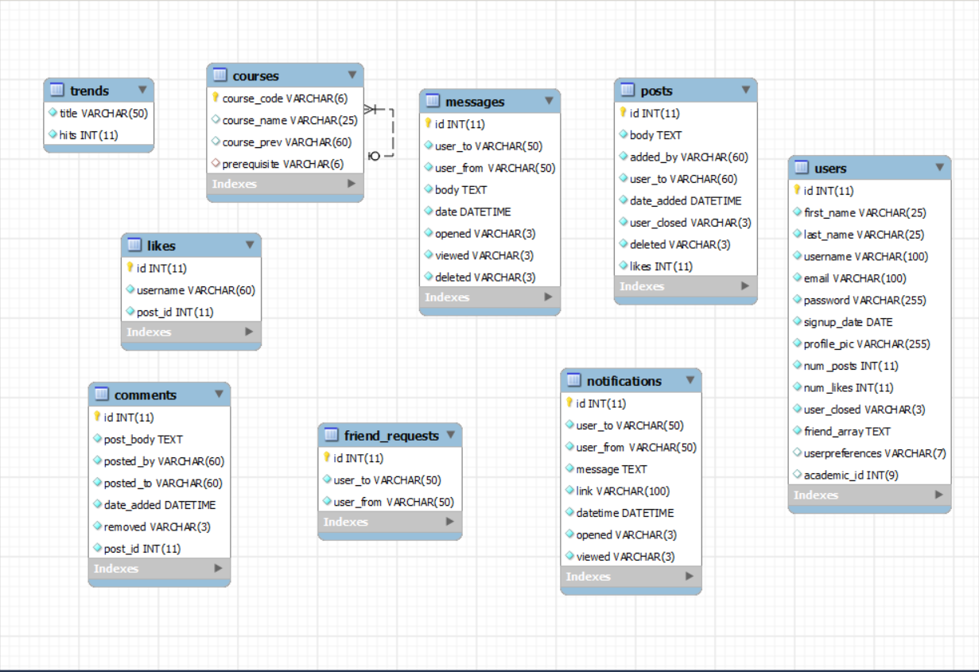
ERD
12

Slide 13
Thanks!
ANY QUESTIONS?
13

